Slide 1











Happiness

Slide 2
Happiness

Slide 3
Agenda
1
The beginning
2
World events
3
Analysis
4
Conclusions

Slide 4
Agenda
1
The beginning
2
World events
3
Analysis
4
Conclusions

Slide 5
Agenda
1
The beginning
2
World events
3
Analysis
4
Conclusions

Slide 6
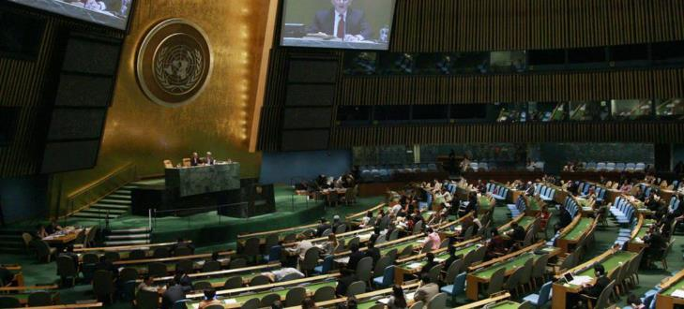
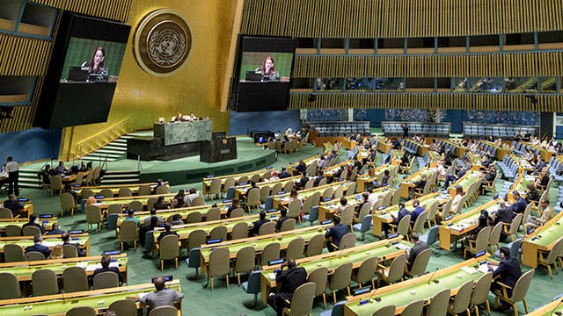
Agenda
1
The beginning...
The Bhutanese Resolution – July 19, 2011-GNH
“The pursuit of happiness is a fundamental human goal”
2
Tema 2
3
Tema 3
Notes:
https://en.wikipedia.org/wiki/Gross_National_Happiness
The General Assembly today called on United Nations Member States to undertake steps that give more importance to happiness and well-being in determining how to achieve and measure social and economic development.
In a resolution adopted without a vote, the Assembly invited countries “to pursue the elaboration of additional measures that better capture the importance of the pursuit of happiness and well-being in development with a view to guiding their public policies.”
The resolution said “the pursuit of happiness is a fundamental human goal” and embodies the spirit of the globally agreed targets known as the Millennium Development Goals (MDGs).
Member States also welcomed the offer of Bhutan, which for many years has used gross national happiness rather than gross domestic product (GDP) as a marker of success, to convene a panel discussion on the theme of happiness and well-being during the Assembly’s next session, which begins in September.
The resolution notes that the GDP indicator “was not designed to and does not adequately reflect the happiness and well-being of people in a country,” and “unsustainable patterns of production and consumption can impede sustainable development.”
Meanwhile, the Assembly today also adopted a resolution stressing the importance of equality among the six official UN languages – Arabic, Chinese, English, French, Russian and Spanish.

Slide 7
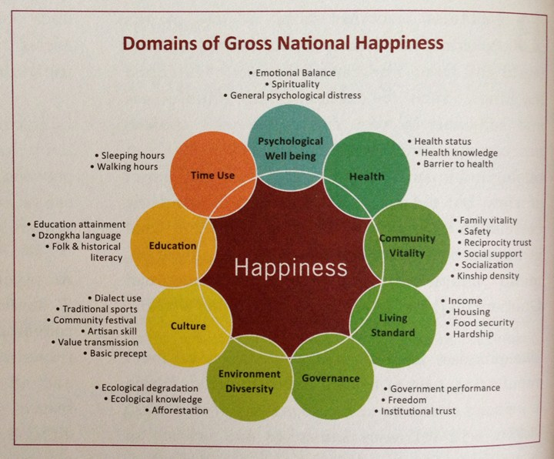
GNH CONCEPT

Slide 8
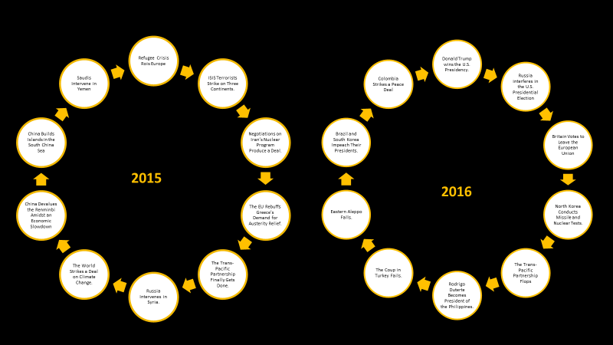
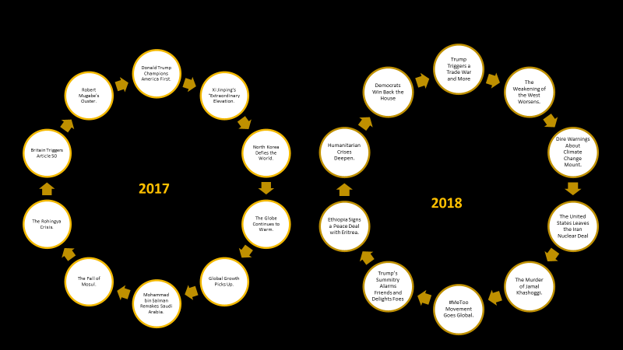
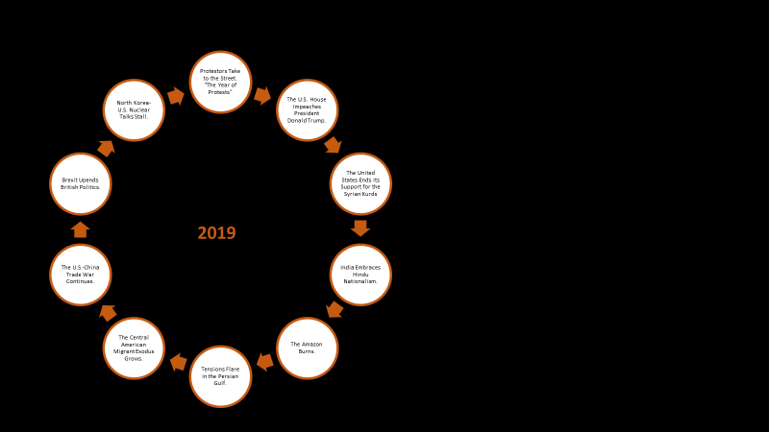
Agenda
2
World Events
2
World events
3
Analysis
4
Conclusions

Slide 9
Refugee Crisis Rois Europe
ISIS Terrorists Strike on Three Continents.
Negotiations on Iran’s Nuclear Program Produce a Deal.
The EU Rebuffs Greece’s Demand for Austerity Relief.
The Trans-Pacific Partnership Finally Gets Done.
Russia Intervenes in Syria.
The World Strikes a Deal on Climate Change.
China Devalues the Renminbi Amidst an Economic Slowdown
China Builds Islands in the South China Sea
Saudis Intervene in Yemen
Donald Trump wins the U.S. Presidency.
Russia interferes in the U.S. Presidential Election
Britain Votes to Leave the European Union
North Korea Conducts Missile and Nuclear Tests.
The Trans-Pacific Partnership Flops
Rodrigo Duterte Becomes President of the Philippines.
The Coup in Turkey Fails.
Eastern Aleppo Falls.
Brazil and South Korea Impeach Their Presidents.
Colombia Strikes a Peace Deal
2015
2016
Notes:
https://www.cfr.org/blog/ten-most-significant-world-events-2015
https://www.cfr.org/blog/ten-most-significant-world-events-2016

Slide 10
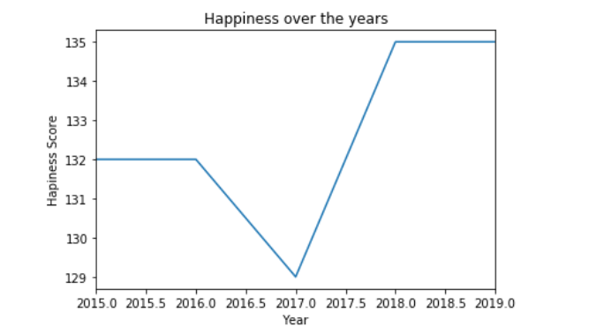
2017, a very good year?

Slide 11
Trump Triggers a Trade War and More
The Weakening of the West Worsens.
Dire Warnings About Climate Change Mount.
The United States Leaves the Iran Nuclear Deal
The Murder of Jamal Khashoggi.
#MeToo Movement Goes Global.
Trump’s Summitry Alarms Friends and Delights Foes
Ethiopia Signs a Peace Deal with Eritrea.
Humanitarian Crises Deepen.
Democrats Win Back the House
Donald Trump Champions America First.
Xi Jinping’s “Extraordinary Elevation.
North Korea Defies the World.
The Globe Continues to Warm.
Global Growth Picks Up.
Mohammad bin Salman Remakes Saudi Arabia.
The Fall of Mosul.
The Rohingya Crisis.
Britain Triggers Article 50
Robert Mugabe’s Ouster.
2017
2018
Notes:
https://www.cfr.org/blog/ten-most-significant-world-events-2017
https://www.cfr.org/blog/ten-most-significant-world-events-2018

Slide 12
Protestors Take to the Street. “The Year of Protests”
The U.S. House Impeaches President Donald Trump.
The United States Ends Its Support for the Syrian Kurds
India Embraces Hindu Nationalism.
The Amazon Burns.
Tensions Flare in the Persian Gulf.
The Central American Migrant Exodus Grows.
The U.S.-China Trade War Continues.
Brexit Upends British Politics.
North Korea-U.S. Nuclear Talks Stall.
2020
Are we going to be happy in 2020?
2019
Notes:
https://www.cfr.org/blog/ten-most-significant-world-events-2019

Slide 13
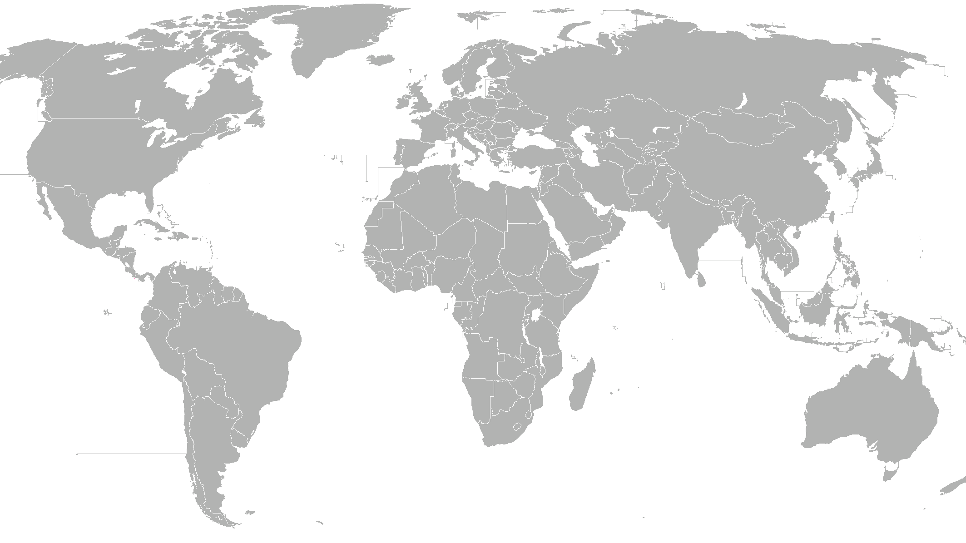



Top 10 countries 2015 2016 2017 2018 2019

Slide 14


Tail 10 countries 2015 2016 2017 2018 2019
Notes:
Central Africa Republic
Chad
Guinea
Ivory Coast
Burkina Faso
Afghanistan
Rwanda
Benin
Syria
Burundi
Togo

Slide 15
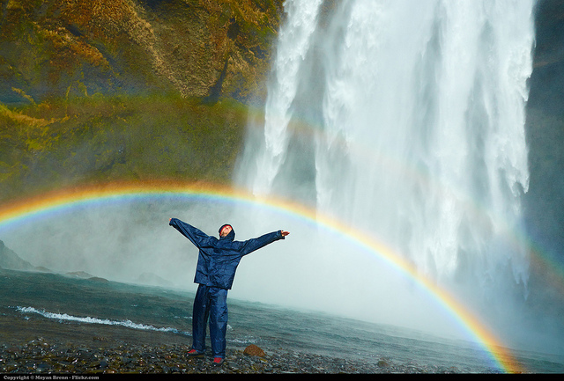
2019 : Environment for happiness
Social environment,
Happiness in cities and rural areas,
Natural environment,
Happiness and sustainable development

Slide 16
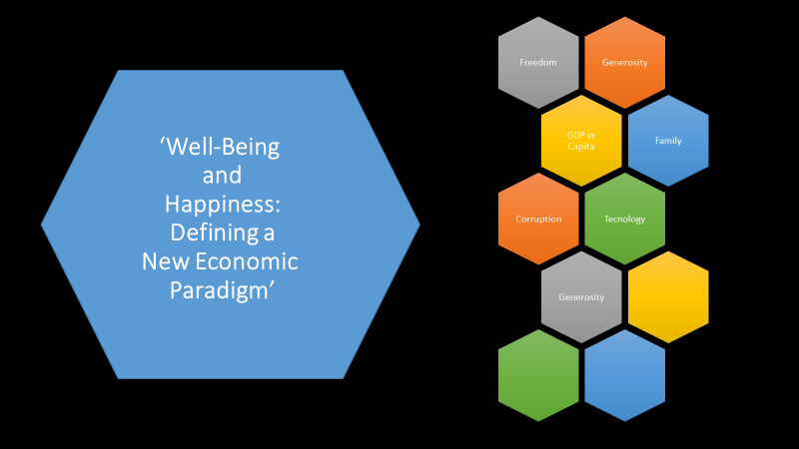
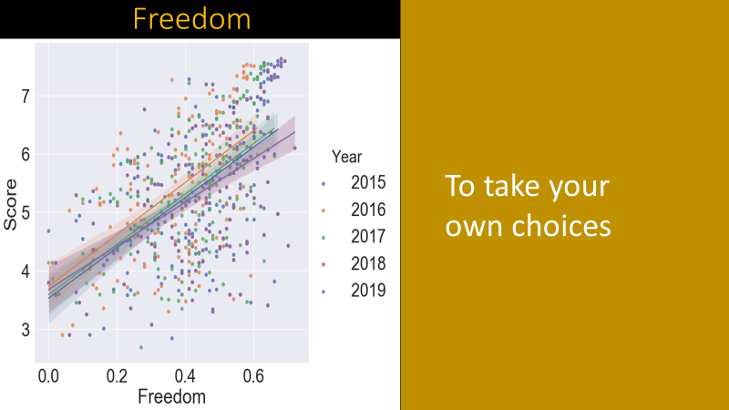
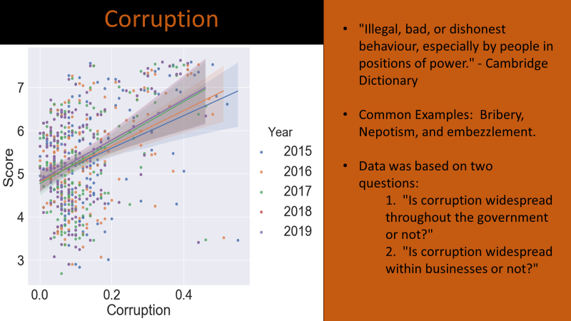
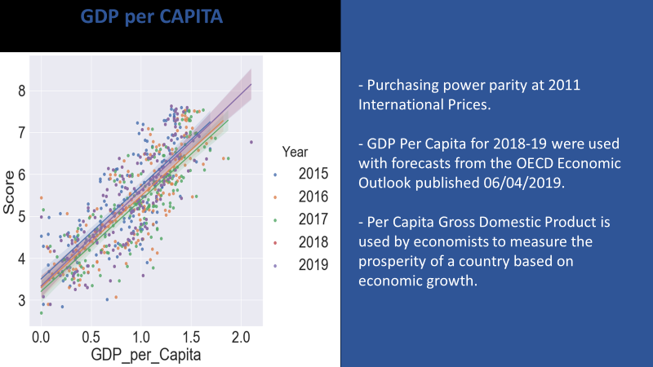
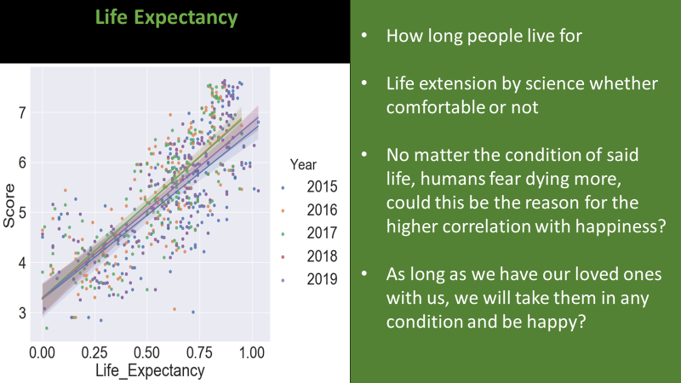
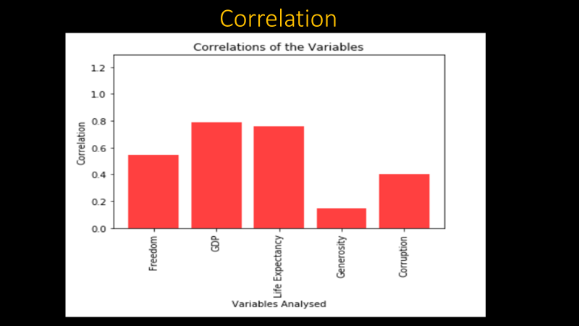
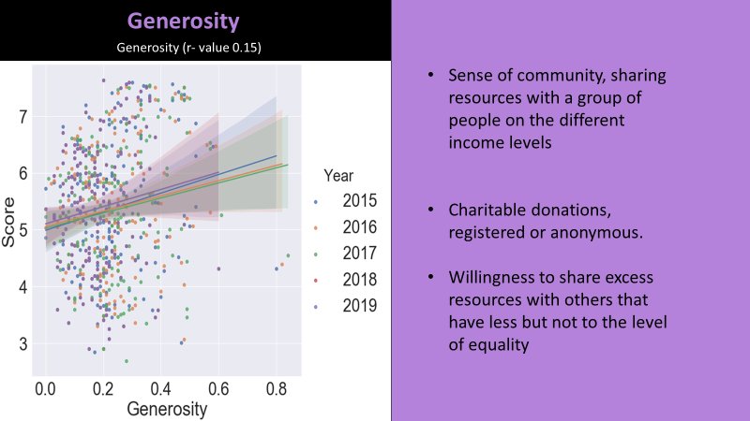
Agenda
3
Analysis
2
World events
3
Analysis
4
Conclusions

Slide 17
‘Well-Being and Happiness: Defining a New Economic Paradigm’
Generosity
Freedom
GDP er Capita
Family
Tecnology
Corruption
Generosity

Slide 18
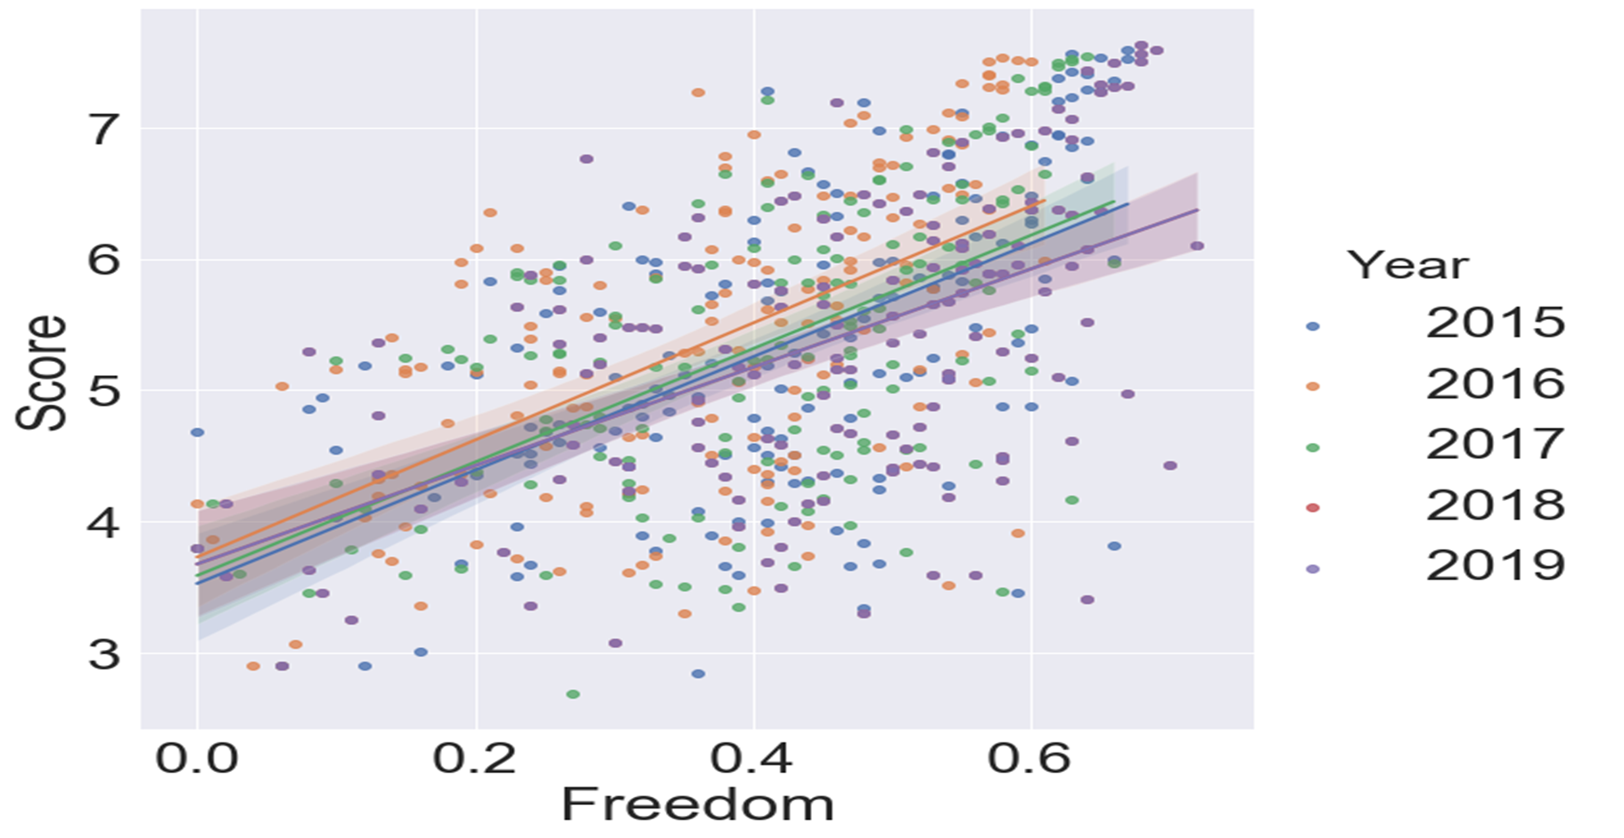
Freedom
To take your own choices

Slide 19
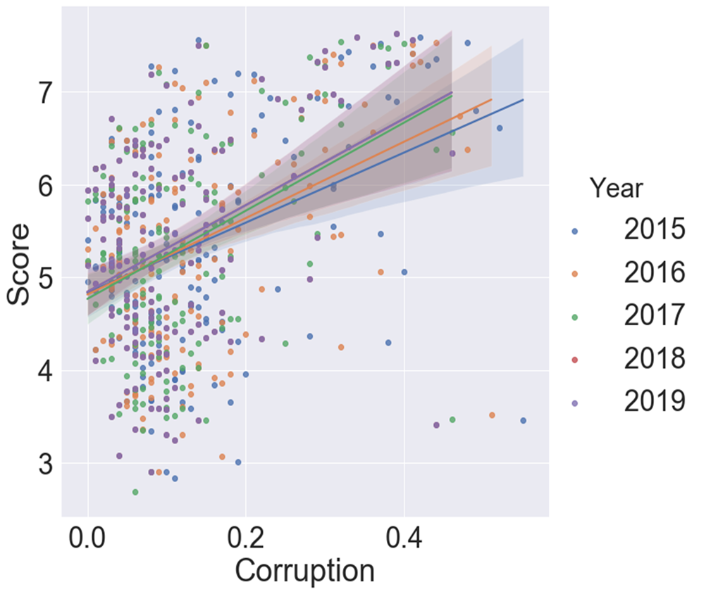
Corruption
"Illegal, bad, or dishonest behaviour, especially by people in positions of power." - Cambridge Dictionary
Common Examples: Bribery, Nepotism, and embezzlement.
Data was based on two questions:
1. "Is corruption widespread throughout the government or not?"
2. "Is corruption widespread within businesses or not?"

Slide 20
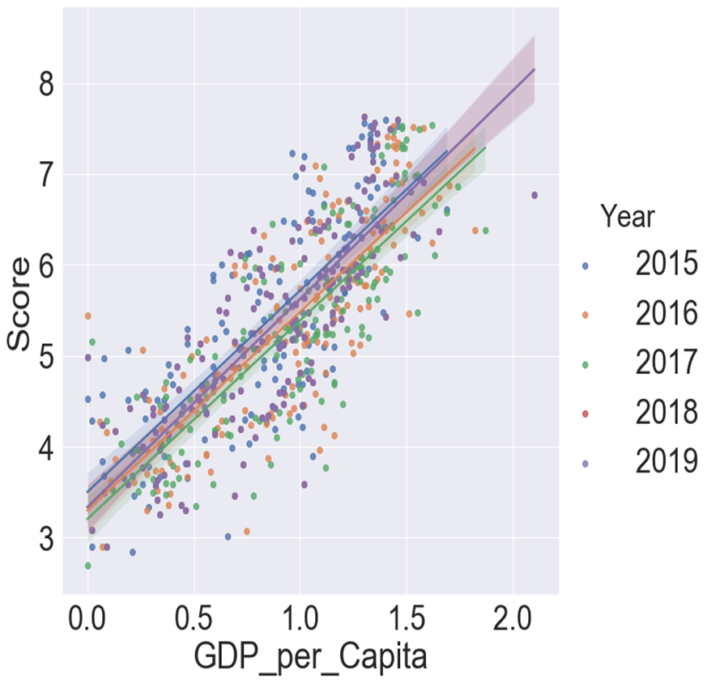
GDP per CAPITA
- Purchasing power parity at 2011 International Prices.
- GDP Per Capita for 2018-19 were used with forecasts from the OECD Economic Outlook published 06/04/2019.
- Per Capita Gross Domestic Product is used by economists to measure the prosperity of a country based on economic growth.

Slide 21
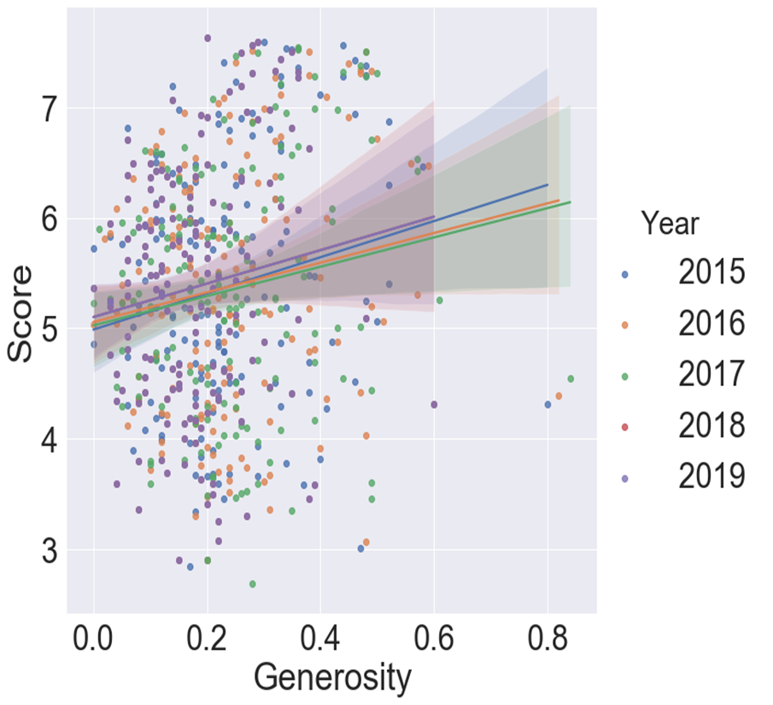
Generosity
Generosity (r- value 0.15)
Sense of community, sharing resources with a group of people on the different income levels
Charitable donations, registered or anonymous.
Willingness to share excess resources with others that have less but not to the level of equality

Slide 22
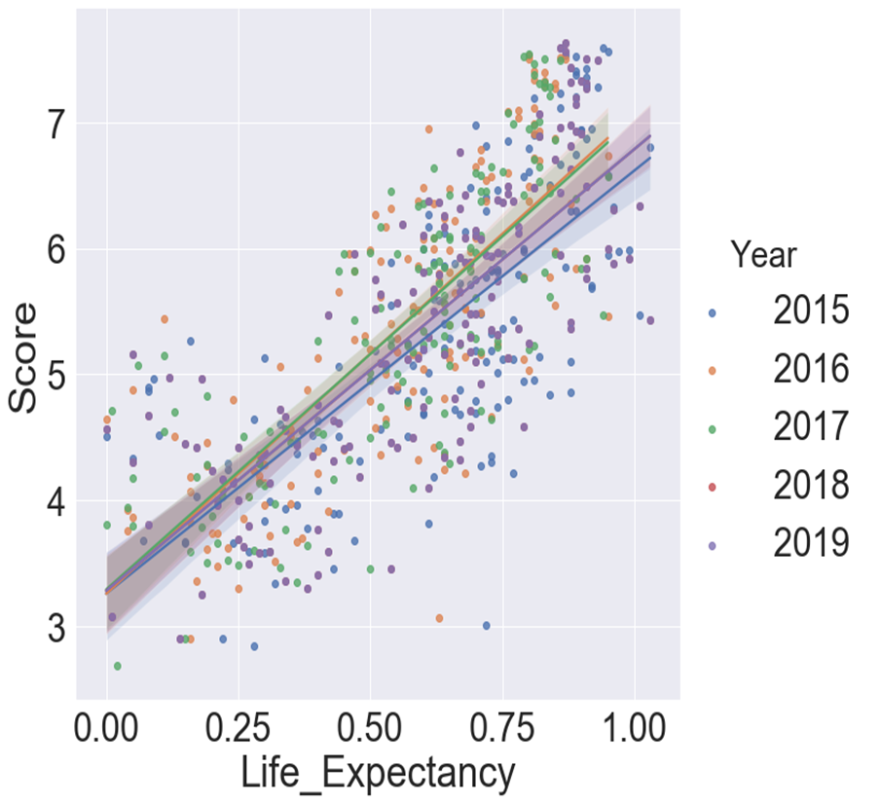
Life Expectancy
How long people live for
Life extension by science whether comfortable or not
No matter the condition of said life, humans fear dying more, could this be the reason for the higher correlation with happiness?
As long as we have our loved ones with us, we will take them in any condition and be happy?

Slide 23
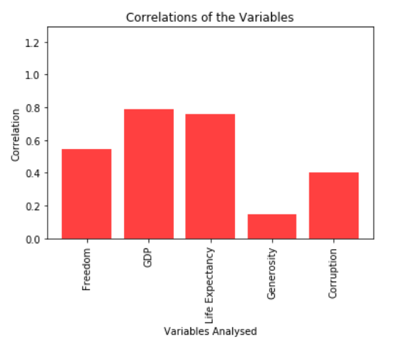
Correlation

Slide 24
Analysis per Region
North America
Africa
Latin America and Caribbean
Western Europe
Middle East
Southeastern Asia

Slide 25
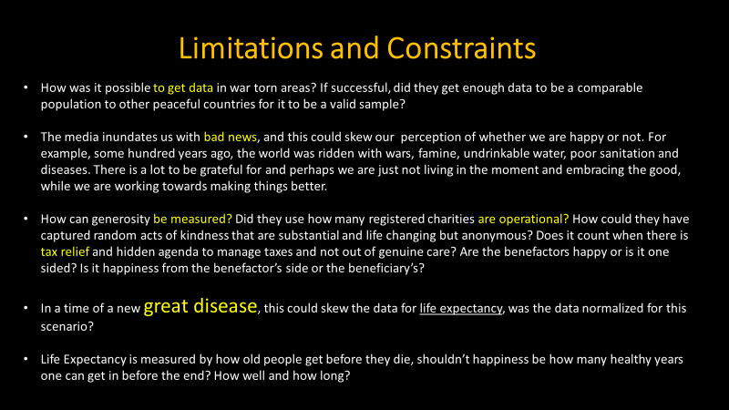
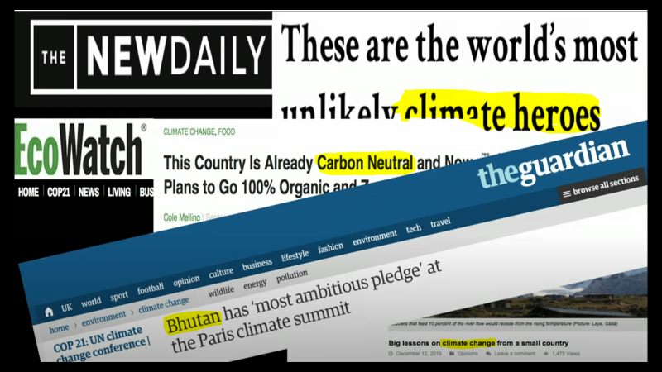
Agenda
4
Conclusions
2
World events
3
Analysis
4
Conclusions

Slide 26
Limitations and Constraints
How was it possible to get data in war torn areas? If successful, did they get enough data to be a comparable population to other peaceful countries for it to be a valid sample?
The media inundates us with bad news, and this could skew our perception of whether we are happy or not. For example, some hundred years ago, the world was ridden with wars, famine, undrinkable water, poor sanitation and diseases. There is a lot to be grateful for and perhaps we are just not living in the moment and embracing the good, while we are working towards making things better.
How can generosity be measured? Did they use how many registered charities are operational? How could they have captured random acts of kindness that are substantial and life changing but anonymous? Does it count when there is tax relief and hidden agenda to manage taxes and not out of genuine care? Are the benefactors happy or is it one sided? Is it happiness from the benefactor’s side or the beneficiary’s?
In a time of a new great disease, this could skew the data for life expectancy, was the data normalized for this scenario?
Life Expectancy is measured by how old people get before they die, shouldn’t happiness be how many healthy years one can get in before the end? How well and how long?

Slide 27
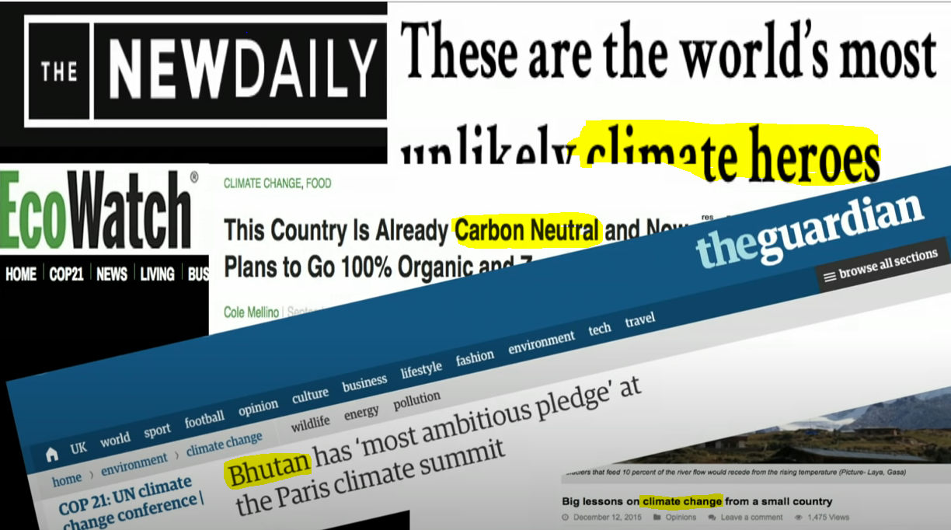
Limitations and Constraints

Slide 28
Resources
Kaggle: https://www.kaggle.com/unsdsn/world-happiness
https://data.world/laurel/world-happiness-report-data
https://www.cfr.org/blog/ten-most-significant-world-events-2015
Tshering Tobgay, This country isn’t just carbon Neutral, it’s carbon negative
https://www.youtube.com/watch?v=7Lc_dlVrg5M
Databases

Slide 29
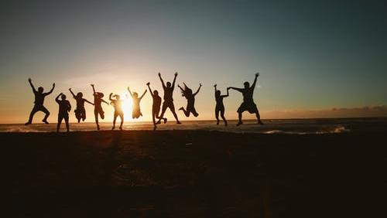
“The perfect human being is all human beings put together, it is a collective, all of us together that make perfection.“
Socrates

